Slide 1
Business Analytics
Dave Eargle – CU Boulder
MGMT 3200 / MKTG 3201

Slide 2
Moneyball
The story of Oakland A's general manager Billy Beane's successful attempt to put together a baseball club on a budget by employing computer-based data analysis to draft his players.

Slide 3
Roles in data science
Data Scientist
Understanding the potential
Can translate from business to execution
Ability to evaluate proposal and execution
Can do the actual modeling
Applied statistician X computer scientist
3

Slide 4
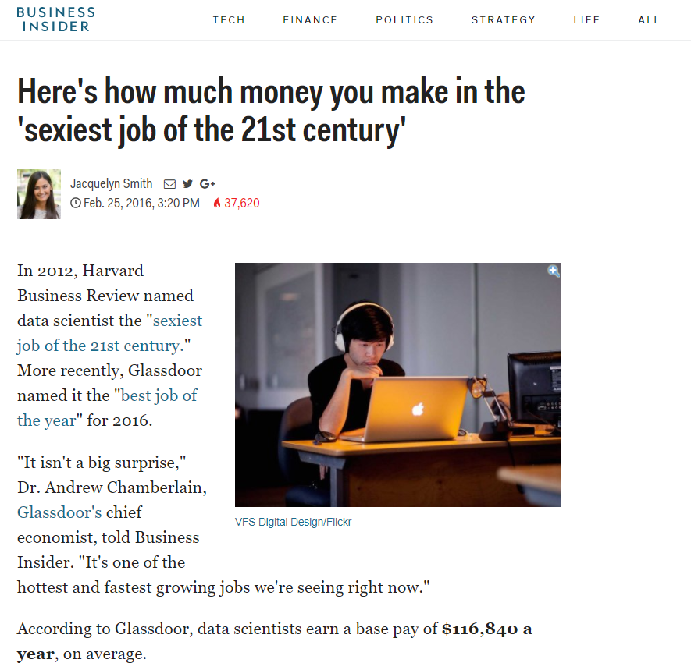

Slide 5
Roles in data science
Data Scientist
Understanding the potential
Can translate from business to execution
Ability to evaluate proposal and execution
Can do the actual modeling
Applied statistician X computer scientist
Collaborator in a data-science project
Managing a data-science project
Investing in a data-science project
Understanding the potential
Can translate from business to execution
Ability to evaluate proposal and execution
5
Notes:
Jonah Hill – Peter Brand
Brad – Billy Beane

Slide 6
The goal for this class is three-fold
Approach business problems data-analytically
Think carefully & systematically about whether & how data can improve performance
Be able to interact competently on the topic of data mining for business analytics
Know the basics of data mining processes, techniques, & concepts well enough
Receive hands-on experience mining data
You should be able to follow up on ideas or opportunities that present themselves
Notes:
“Develop in you the tendency to..” → Data has become an indispensible strategic asset for almost all businesses; firms and individuals who think data-analytically will have a competitive advantage
Interact with technical people, direct your CTO, assess the prospects for companies (e.g., is there a data-mining angle to Microsoft’s acquisition of Skype? – the internet telephony startup, or why gmail might be valuable to Google?)
You’re not going to be a data mining expert after this class – in fact there are entire masters programs (and Ph.D. programs) specializing in data mining. However, you should be able to do straightforward pilot studies using basic techniques. In a position to get a more advanced book and do more if it will benefit your job some time.

Slide 7
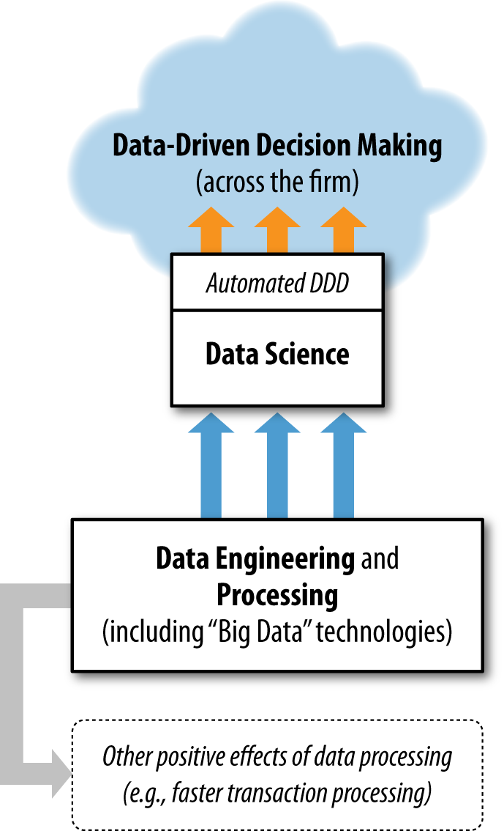
What do we really
care about?

Slide 8
What really is data mining?
A process for using information technology to extract useful (non-trivial, hopefully actionable) knowledge from large bodies of data

Slide 9
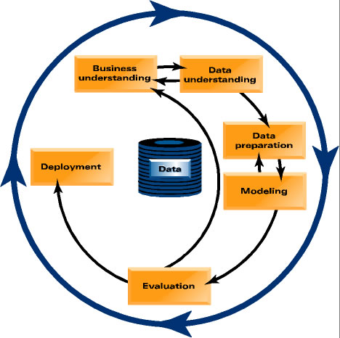
The Process
(Big?)
Notes:
http://www.crisp-dm.org/Process/index.htm
Cross Industry Standard Process for Data Mining

Slide 10
Business data science is a process
science + craft + creativity + common sense
a process
Notes:
what is it in practice?
science and craft can be taught
proper application creativity can come through experience
for a craft to be consistently effective, it is important to have a well-understood process
common sense, and business sense

Slide 11
TelCo: An example business problem
TelCo, a major telecommunications firm, wants to investigate its problem with customer attrition, or “churn”
Lets consider this for now as a marketing problem only
How would you go about targeting some customers with a special offer, prior to contract expiration? Think about what data should be available for your use.

Slide 12
Today’s mini case: What data might TelCo mine to help with churn management?
12
Notes:
12
Account specifics (pricing plan, etc.), usage, demographics
PLUS! Prior data on retention and attrition! [would be very helpful]
→ introduce notion of target variable, for use when differentiate classificatiion, regression, time series

Slide 13
Types of Data Mining Tasks

Slide 14
Types of Data Mining Tasks
Many business problems have as an important component one of these data mining tasks:
Affinity grouping (a.k.a. “associations”, “market-basket analysis”)
What items are commonly purchased together?
Similarity Matching
What other companies are like our best small business customers?
Description/Profiling
What does “normal behavior” look like?
Clustering
Do my customers form natural groups?
Predictive Modeling (including causal modeling & link prediction)
Will customer X churn next month/default on her loan?
How much would prospect X spend?
Who might be good “friends” on our social networking site?
Unsupervised
Supervised
14
Notes:
14

Slide 15
Other examples
Walmart with a huge storm approaching
Target, predict pregnancy before any competitors do
Credit card fraud and Medicare fraud
Amazon and Netflix movie recommendations
Amazon product recommendations
Facebook friend recommendations
Judges using analytics to determine sentencing
likelihood of committing another crime
Notes:
http://www.nytimes.com/2012/02/19/magazine/shopping-habits.html?pagewanted=1&_r=1&hp

